Slide 1
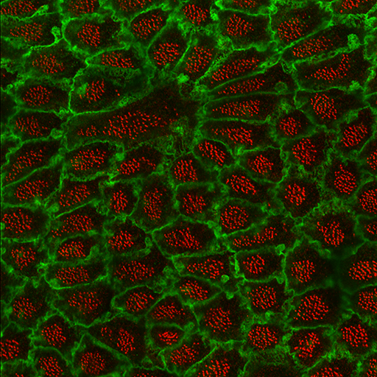
Optical Sectioning and Confocal Microscopy Kurt Thorn

Slide 2
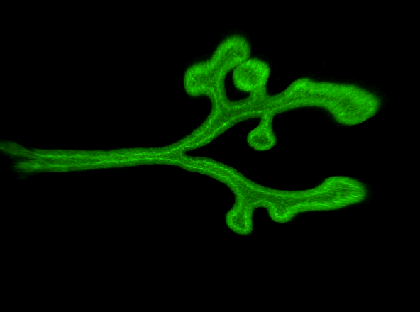
The goal: build 3D images of biological samples
Embryonic mouse lung; Nan Tang, Martin lab

Slide 3
Optical Sectioning and 3D reconstruction
z
x
y

Slide 4
Optical Sectioning and 3D reconstruction
z
x
y

Slide 5
Optical Sectioning and 3D reconstruction
=
z
x
y

Slide 6
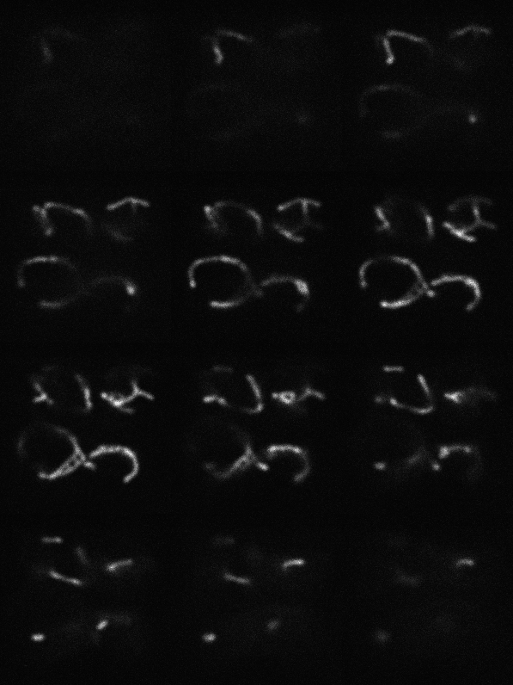
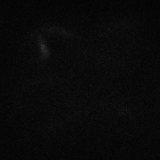
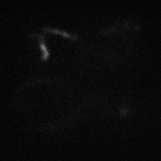
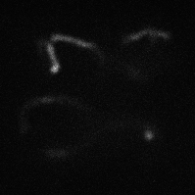
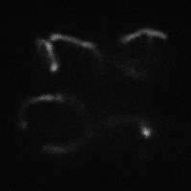
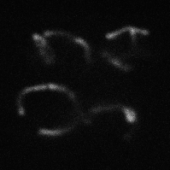
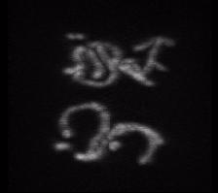
A series of optical sections
Yeast mitochondria; Susanne Rafelski

Slide 7
Fluorescence Illumination of a single point
Camera
Tube lens
Excitation light
Emission light
Objective lens
Sample
Problem – fluorescence is emitted along entire illuminated cone, not just at focus

Slide 8
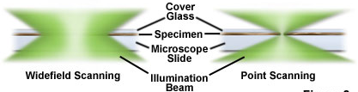
Widefield fluorescence imaging
Widefield Illumination
Point Illumination

Slide 9
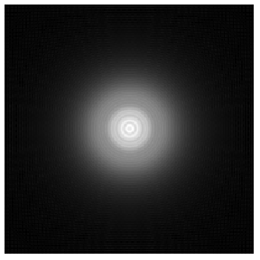
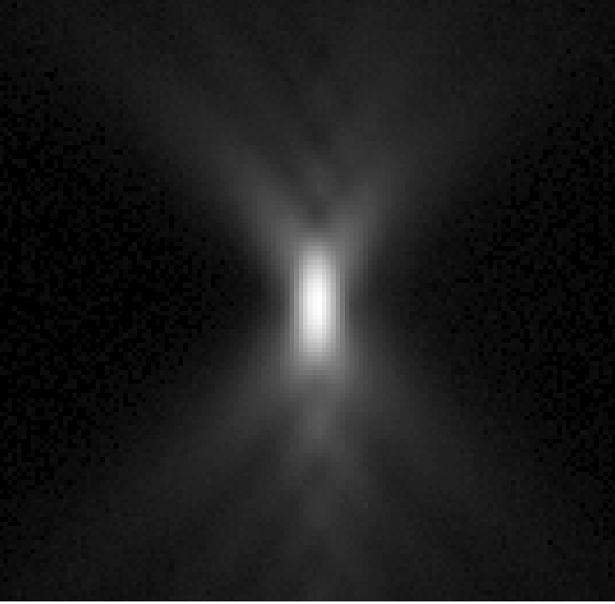
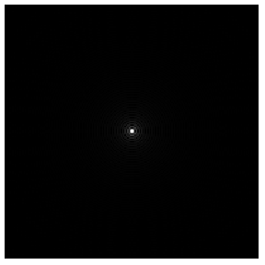
The Point Spread Function (PSF)
The image of a point object
2D PSF
for different defocus
Z=+2µm
3D PSF
Calculated
Measured
z
Z=0
Z=-2µm
y
x
x

Slide 10
The Problem of Out-of-Focus Light
Three Options
Prevent it from reaching the detector
Confocal microscopy
Prevent it from being excited
Two-photon, light sheet microscopy, TIRF
Remove it after the fact (computationally)
Deconvolution

Slide 11
Fluorescence Illumination of a single point
Camera
Tube lens
Excitation light
Emission light
Objective lens
Sample
Problem – fluorescence is emitted along entire illuminated cone, not just at focus

Slide 12
The confocal microscope
Scan excitation spot point-by-point to build up image
Detector
Pinhole
Tube lens
Excitation light
Emission light
Objective lens
Sample

Slide 13
How big should your pinhole be?
Resolution is limited by the point-spread function
Y
X
Airy disk radius
≈ 0.61 λ /NA
Z

Slide 14
How big should your pinhole be?
Want pinhole to pass entire Airy disk
Y
X
Airy disk diameter
≈ 1.22 λ /NA
Width of point spread function at pinhole: Airy disk diameter × magnification of lens

Slide 15
How big should your pinhole be?
Width of point spread function at pinhole = Airy disk diameter × magnification of lens = 1 Airy unit = resolution of lens × magnification of lens × 2
100x / 1.4 NA: resolution = 220nm, so 1 Airy unit = 44 μm
40x / 1.3 NA: resolution = 235nm, so 1 Airy unit = 19 μm
20x / 0.75 NA: resolution = 407nm, so 1 Airy unit = 16 μm
10x / 0.45 NA: resolution = 678nm, so 1 Airy unit = 14 μm

Slide 16
Light sources
Excitation light must be focused to a diffraction limited spot
Could be done with an arc lamp and pinhole – but very inefficient
Excitation light
Enter the laser:
Perfectly collimated and high power
Objective lens
Sample

Slide 17
Scanning
Changing entrance angle of illumination moves illumination spot on sample
Objective lens
The emission spot moves, so we have to make sure pinhole is coincident with it
Sample

Slide 18
Confocal optical path
Dichroic
Pinhole
Scanning mirrors
x
Detector
y
Laser
Relay lens
Objective

Slide 19
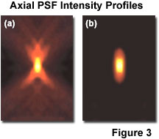
What do you get?

Slide 20
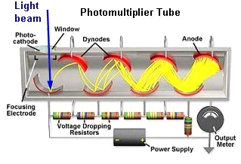
Detectors - PMTs
Must be fast – confocal beam spends only a few μs on each pixel
Photomultiplier tubes
Pulse width for single photon ~ 10-100ns
Very linear
Very high gain
~ 0 read noise

Slide 21
Detectors - PMTs
Peak QE for standard PMT: ~30%
Front-illuminated CCD: ~60%
Back-illuminated CCD: ~95%
GaAsP PMTs: ~40-50%
However, GaAsP PMTs can be damaged by exposure to too much light.

Slide 22
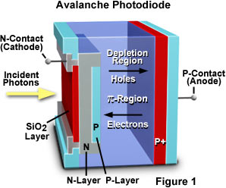
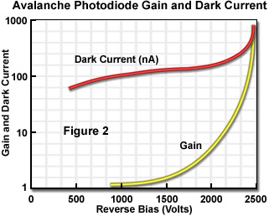
Detectors - APDs
Photons produce photoelectrons
Photoelectrons are amplified by collisional ejection of electrons
Small dynamic range

Slide 23
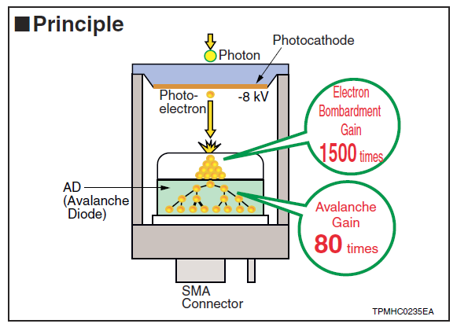
Hybrid Detectors
GaAsP photocathode bombards an APD
Very high gain
Excellent for single photon counting
Damaged by excessive light

Slide 24
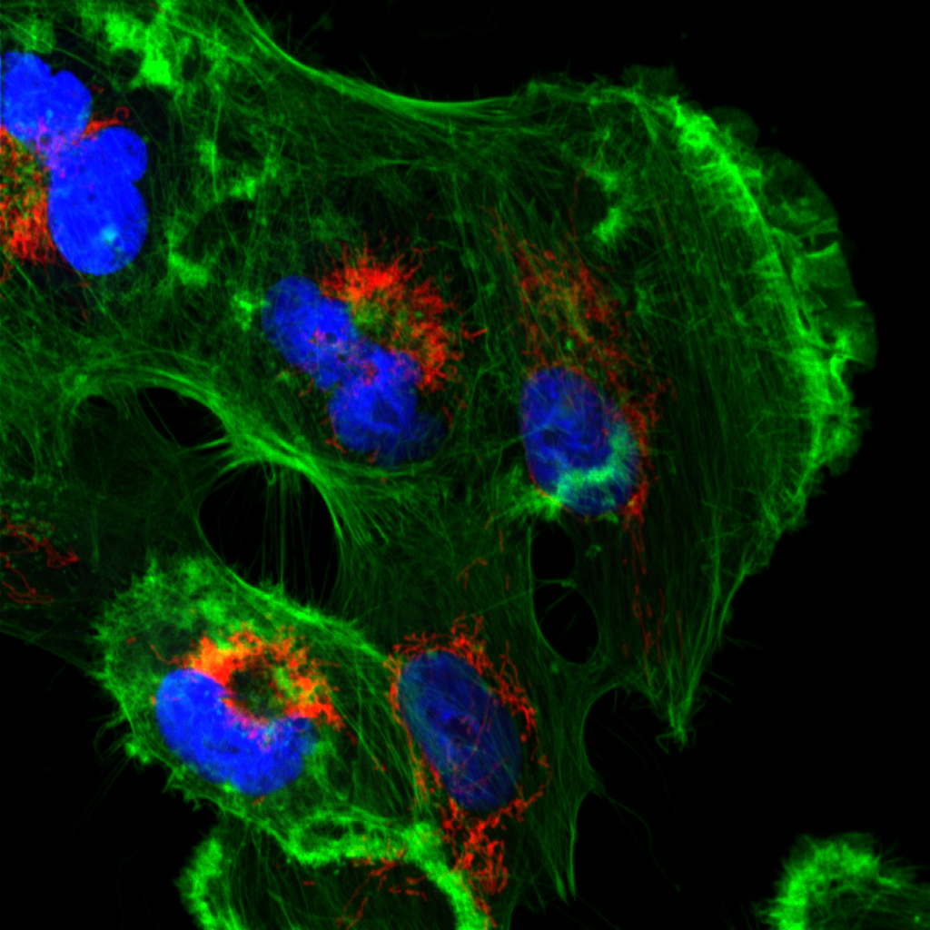
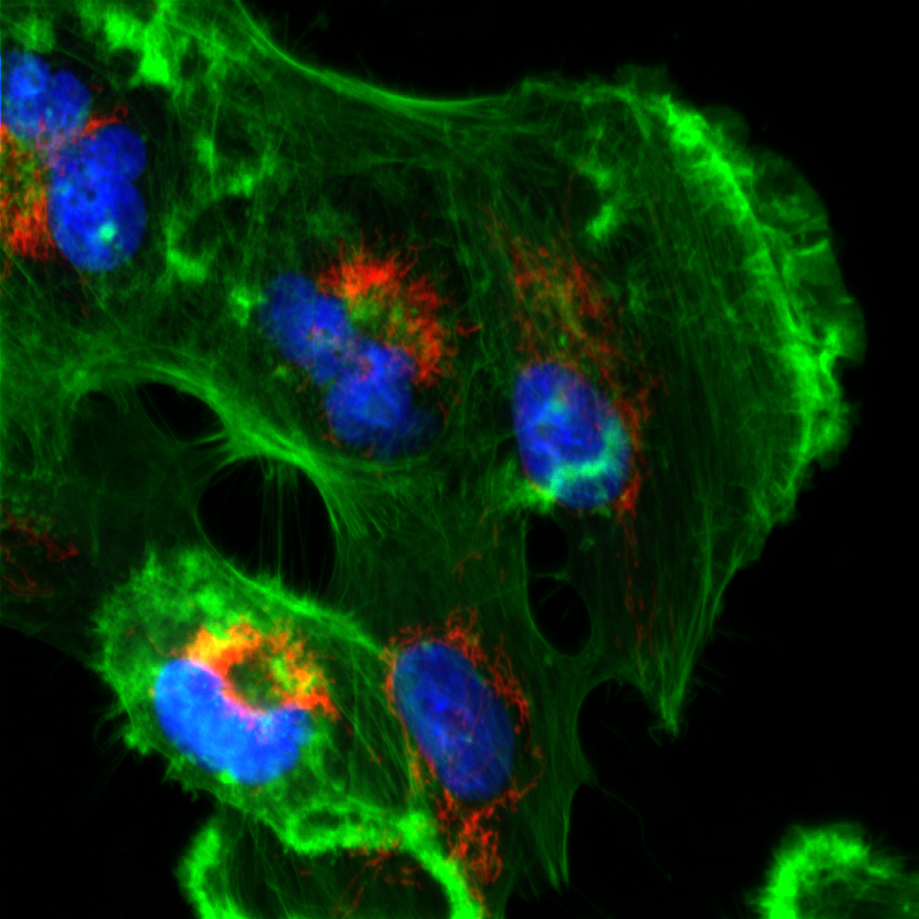
Confocal vs. Widefield
Confocal
Widefield
Tissue culture cell with 60x / 1.4NA objective

Slide 25
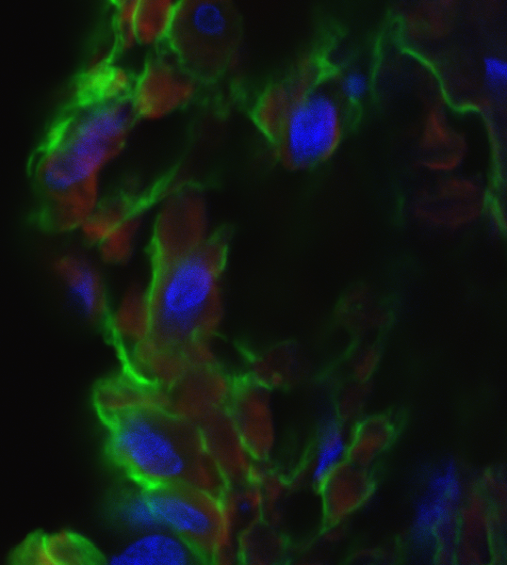
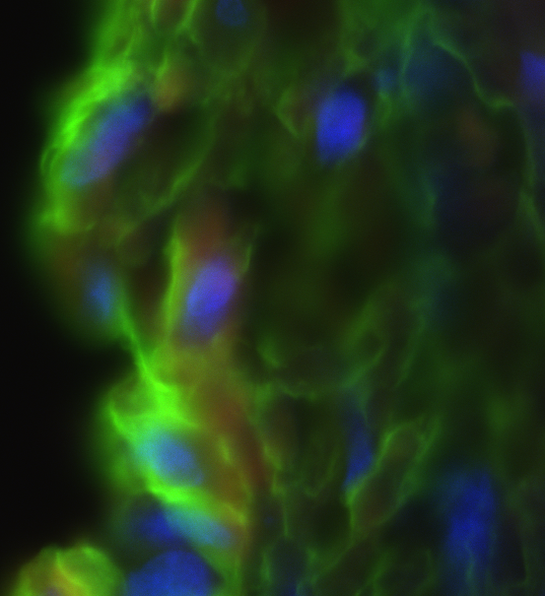
Confocal vs. Widefield
Confocal
Widefield
20 μm rat intestine section recorded with 60x / 1.4NA objective

Slide 26
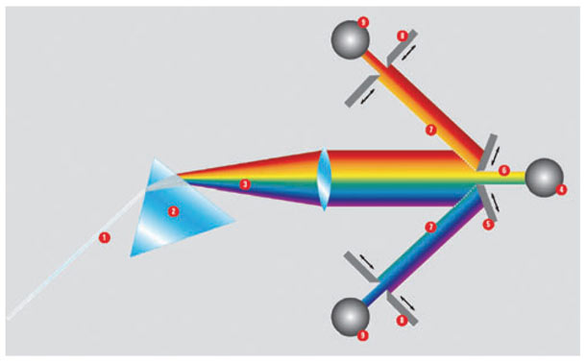
Doing more with your photons
Spectral Detection
Prism + Adjustable Slits: Leica SP microscopes

Slide 27
Doing more with your photons
Spectral Detection
Prism + PMT-array: Zeiss and Nikon

Slide 28
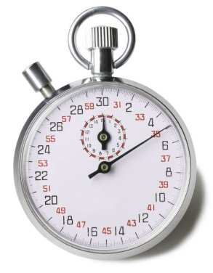
Doing more with your photons
Time-Correlated Single Photon Counting
Single-photon detector
Pulsed Laser

Slide 29
The confocal microscope: Drawbacks
Scan excitation spot point-by-point to build up image
Problems:
Slow (~1 sec to acquire an image)
Low light efficiency (due to use of PMT as detector)
Solution:
Use multiple pinholes and a camera
Detector
Pinhole
Tube lens
Excitation light
Emission light
Objective lens
Sample

Slide 30
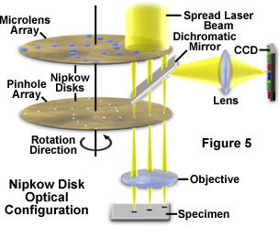
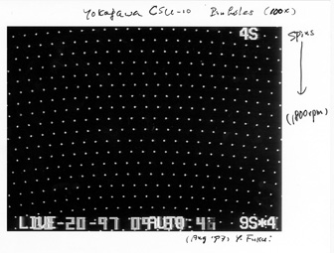
A Solution: Spinning Disk Confocal
Image with many pinholes at once, so fast
Use CCD as detector, so much higher QE

Slide 31
The downside to the spinning disk

Slide 32
The downside to the spinning disk

Slide 33
The downside to the spinning disk

Slide 34
The downside to the spinning disk
Limited out of focus rejection

Slide 35
Pros/Cons of spinning disk
Fast – multiple points are illuminated at once
Photon efficient – high QE of CCD
Gentler on live samples – usually lower laser power
Fixed pinhole size (usually)
Small field of view (usually)
Crosstalk through adjacent pinholes limits sample thickness

Slide 36
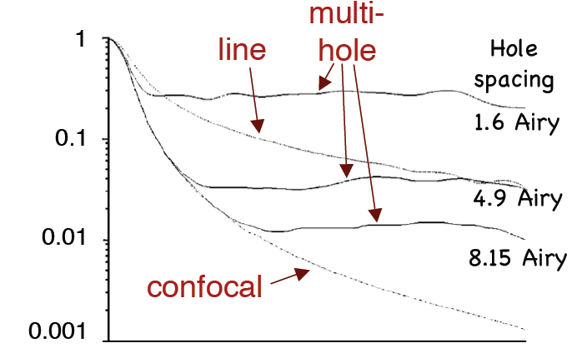
Out-of-focus rejection
T
Defocus
Wolleschensky et al. J. Biomed. Opt. 11(6) 2006

Slide 37
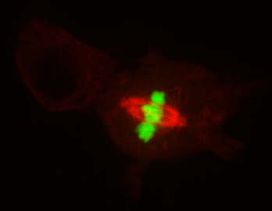

Examples
Drosophila S2 cell expressing GFP-H2B and mCherry-tubulin (Nico Stuurman and Ron Vale)
S. cerevisiae expressing a mitochondrially targeted RFP, Susanne Rafelski, Marshall lab

Slide 38
When to use confocal?
Confocal is not a magic bullet
It is extremely wasteful of photons
Laser-scanning confocal is 100 – 200-fold less sensitive than widefield
Spinning-disk confocal is ~4-fold less sensitive than widefield
Murray JM et al., J. Microsc. 2007, 228: p.390-405

Slide 39
When to use confocal?
Confocal is not a magic bullet
It is extremely wasteful of photons
High laser power generally result in more photobleaching and photodamage.
For thin specimens, widefield epifluorescence is better – especially with deconvolution
Confocal excels with thick, heavily stained specimens

Slide 40
When to use confocal?
What is thick?
A good rule of thumb is 10 × the depth of field of the objective
100x / 1.4 NA: d.o.f. 0.66μm
20x / 0.75 NA: d.o.f 2.3 μm
Sample preparation is KEY for imaging thick specimens
Confocal does not fix scattering, refractive index mismatch, or everything else that can go wrong – it only removes out of focus light

Slide 41
Sample preparation
For fixed samples: match refractive index of mounting media to immersion oil.
Mount in immersion oil itself, BABB, benzyl alcohol/glycerol, 2,2’-thiodiethanol, or other high-RI mounting medium
Clearing to remove lipids and other scattering substances is also important
For live samples, use water immersion lenses

Slide 42
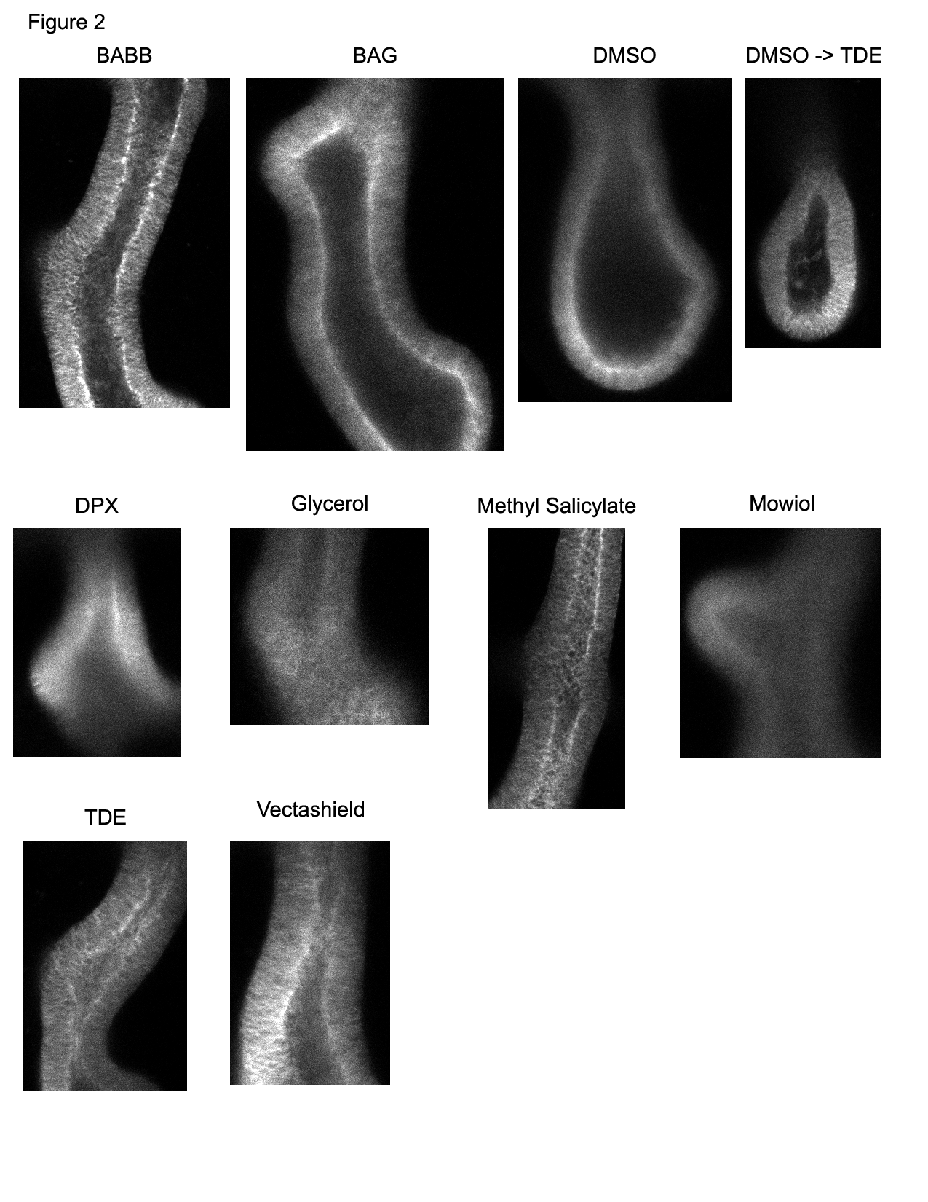
Sample Preparation
Samples imaged with 20x / 0.75 air objective on spectral confocal
Sections acquired ~ 50 μm into tissue
Embryonic mouse lungs; samples from Nan Tang, Martin Lab

Slide 43
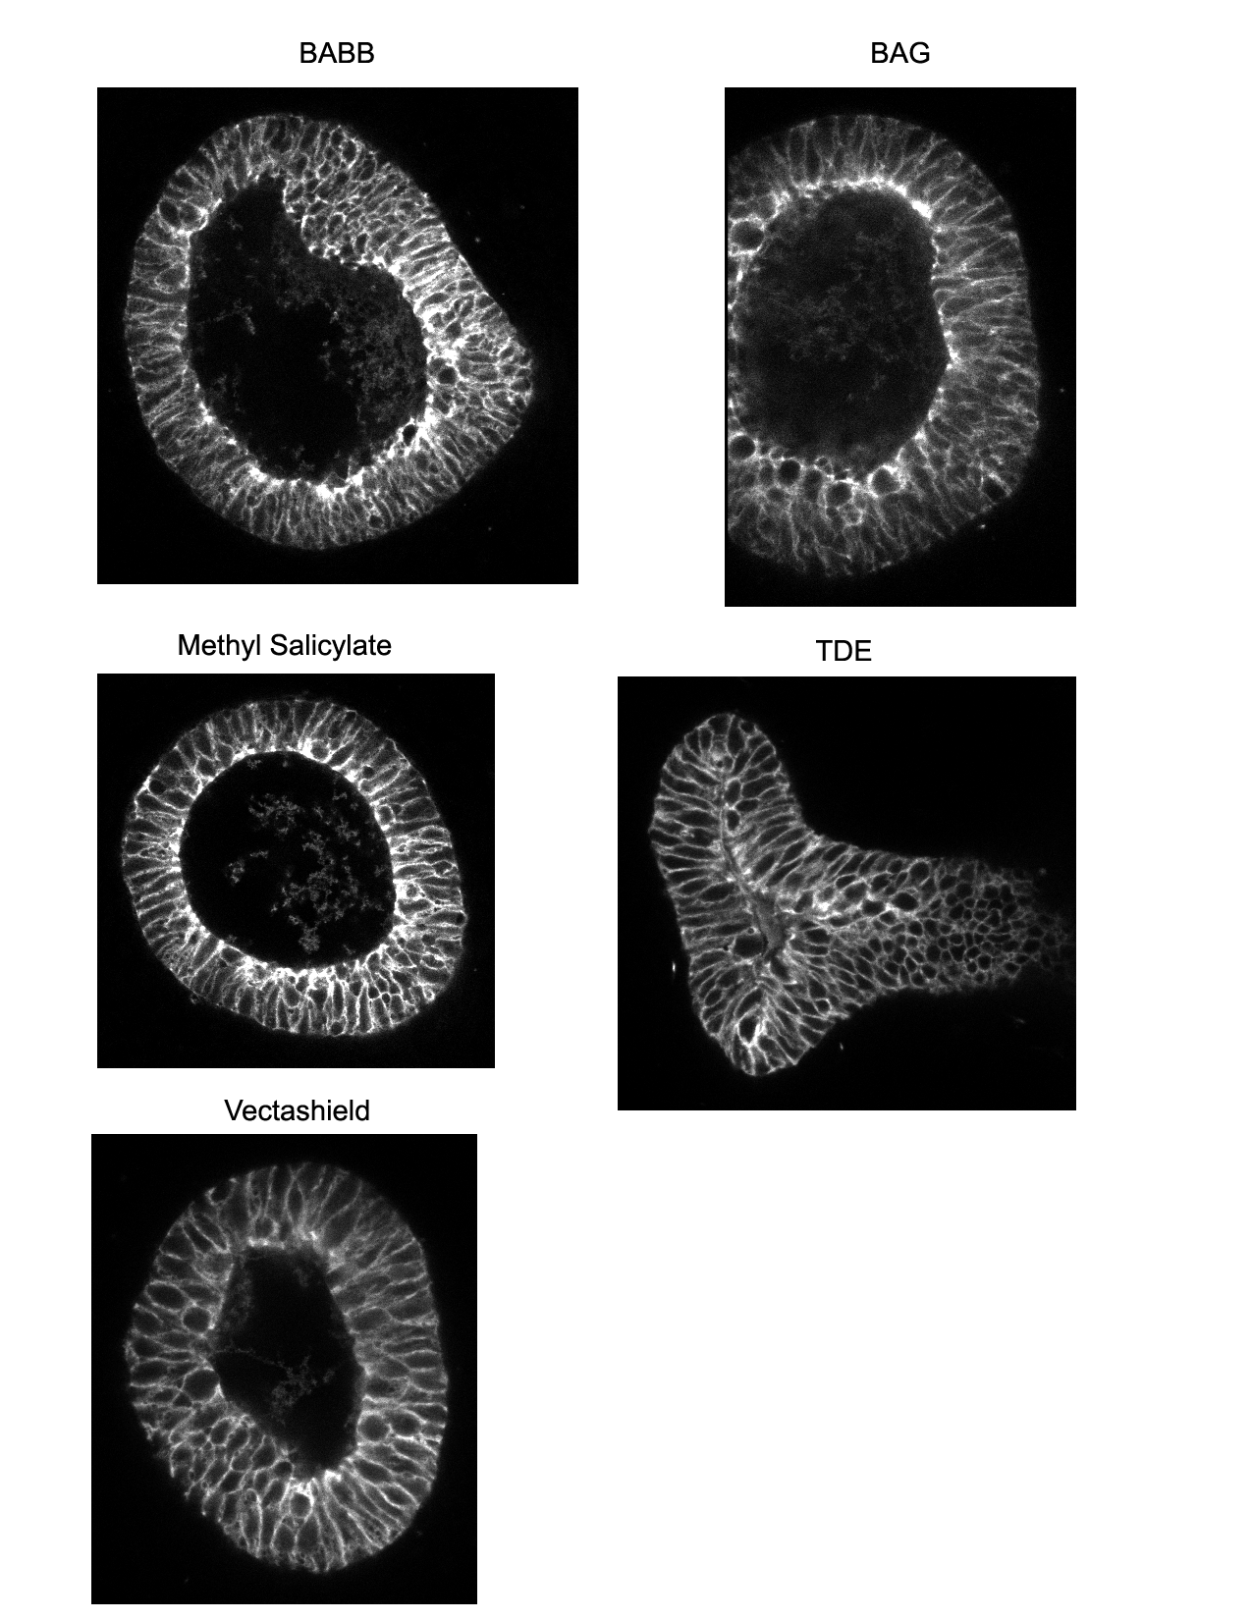
Sample Preparation
Samples imaged with 40x / 1.3 oil objective on spectral confocal
Sections acquired ~ 50 μm into tissue
Embryonic mouse lungs; samples from Nan Tang, Martin Lab

Slide 44
Clearing and mounting summary
Both clearing and refractive index matching are important.
BABB and methyl salicylate clear very well and give best image depth, but may disrupt cell morphology
TDE preserves cell morphology and also allows for decent imaging depth

Slide 45
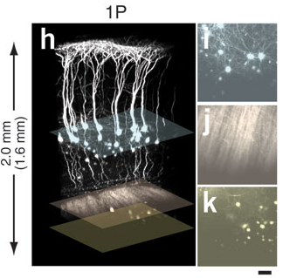
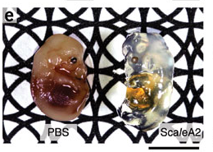
Newer Clearing Techniques
Scale
ScaleA2: 4M urea, 10% glycerol, 0.1% Triton X-100
Hama et al. Nat. Neurosci. 14, p. 1481 (2011)

Slide 46
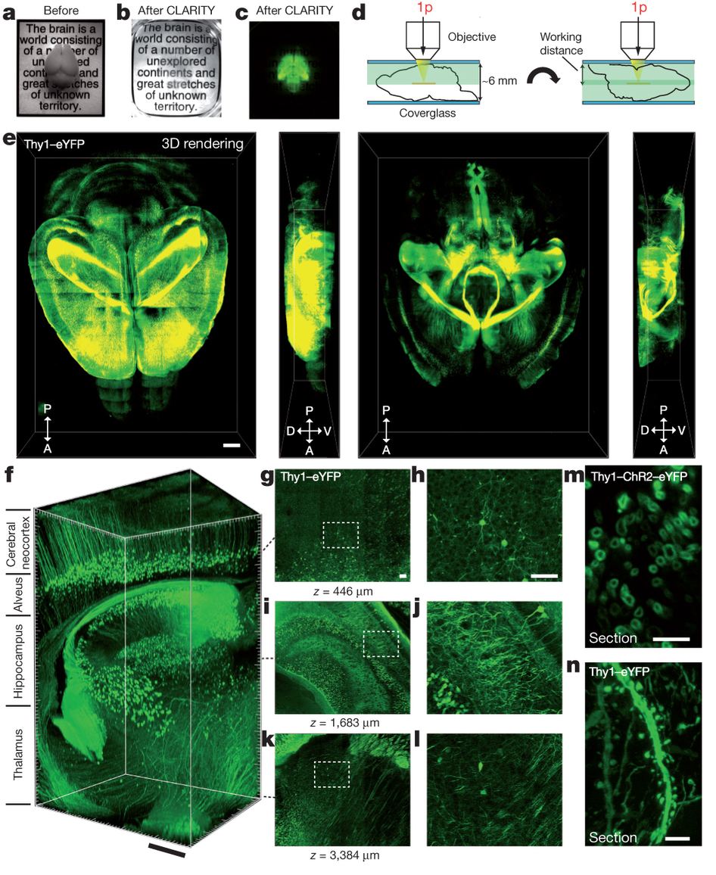
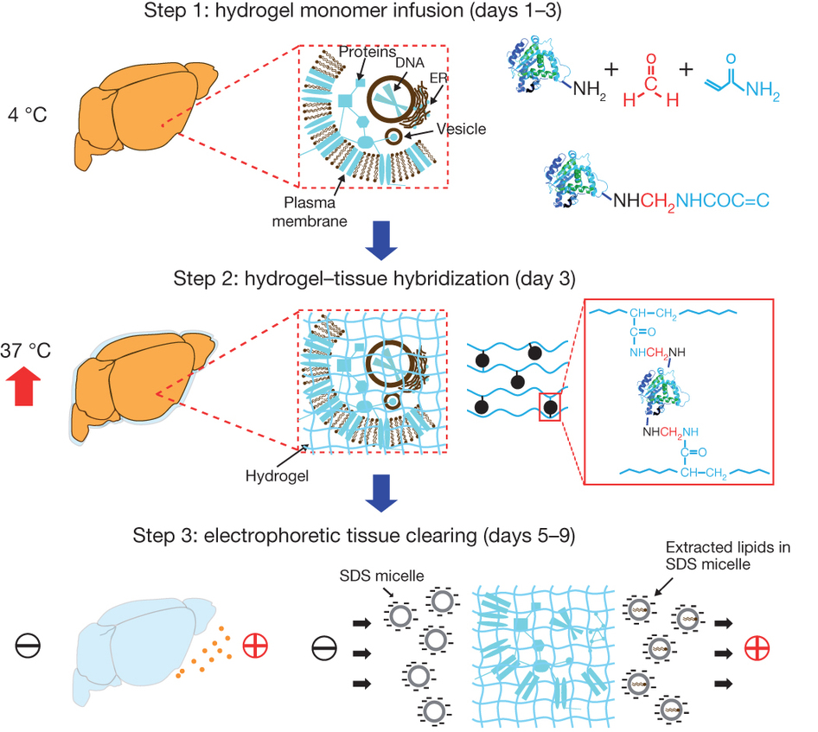
Newer Clearing Techniques
CLARITY
Chung et al. Nature 2013; http://clarityresourcecenter.org/

Slide 47
Resources
http://www.microscopyu.com
http://micro.magnet.fsu.edu
James Pawley, Ed. “Handbook of Biological Confocal Microscopy, 3rd ed.”
http://www.hamamatsu.com/resources/pdf/etd/PMT_handbook_v3aE.pdf
Acknowledgements
Steve Ross, Mats Gustafsson

